Slide 1
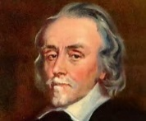
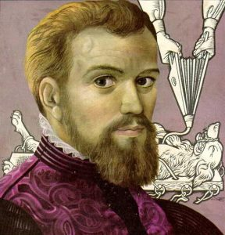
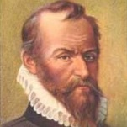
Who was the most significant individual in developing medicine in the Renaissance era?
William Harvey |  |  | Andreas Vesalius |  |  | Ambroise Pare
William Harvey |  |  | Andreas Vesalius |  |  | Ambroise Pare
Area | Score | Explanation | Area | Score | Explanation | Area | Score | Explanation
Causing Change | /10 |  | Causing Change | /10 |  | Causing Change | /10
Spreading Ideas | /10 |  | Spreading Ideas | /10 |  | Spreading Ideas | /10
Accepted by others | /10 |  | Accepted by others | /10 |  | Accepted by others | /10
Relevance Today | /10 |  | Relevance Today | /10 |  | Relevance Today | /10
Causing Change
Causing Change
Causing Change
10
9
8
7
6
5
4
3
2
1
10
9
8
7
6
5
4
3
2
1
10
9
8
7
6
5
4
3
2
1
10 9 8 7 6 5 4 3 2 1
2 3 4 5 6 7 8 9 10
2 3 4 5 6 7 8 9 10
10 9 8 7 6 5 4 3 2 1
2 3 4 5 6 7 8 9 10
Accepted by others
Relevance Today
10 9 8 7 6 5 4 3 2 1
Accepted by others
Relevance Today
1
2
3
4
5
6
7
8
9
10
Accepted by others
1
2
3
4
5
6
7
8
9
10
Relevance Today
1
2
3
4
5
6
7
8
9
10
Spreading Ideas
Spreading Ideas
Spreading Ideas

Slide 2
Causing Change
10
9
8
7
6
5
4
3
2
1
Accepted by others
10 9 8 7 6 5 4 3 2 1
2 3 4 5 6 7 8 9 10
Relevance Today
1
2
3
4
5
6
7
8
9
10
Spreading Ideas

Slide 3
William Harvey
Area | Score | Explanation
Causing Change | /10
Give a score out of 10
Fully explain the score using at least two specific examples and facts about William Harvey.

Slide 4
Key points written in short bullet point form taken from the video – other brief notes have been added from the sheet to ensure all points are covered.
Each of the four areas have been scored out of 10 using the information. The numbers have been linked between the different areas to create a shape – once you’ve done all three people it will be easy to compare!
Short notes added to explain the score.
For each area of significance a score has been given and a full justification has been given using specific evidence about each person.

